Slide 1
Mobile and Embedded Computing
Lecture 2. Languages & Flutter Intro

Slide 2

A compiled language is a programming language that must be translated into machine code before it can run.
Uses a compiler to convert the code into an executable file that the computer can directly run. This translation step happens once, before you run the program.

Slide 3

An interpreted language is a programming language where code is executed line-by-line by an interpreter program at runtime, rather than being pre-compiled into machine code.
The interpreter acts as a middleman between your source code and the computer. When you run a program written in an interpreted language, the interpreter reads your code directly from the source file, translates each line into machine instructions on-the-fly, and executes those instructions immediately.

Slide 4
Differences – Developer Experience – Compiled languages
Slow to develop (edit, compile, link and run. The compile/link steps could take serious time)
You need to "rebuild" the program every time you need to make a change
Compiled languages require longer development cycles but catch errors earlier in the development process
Early error detection during compilation prevents runtime failures
Better for large, complex applications where catching bugs early saves time

Slide 5
Differences – Developer Experience – Interpreted languages
Interpreted languages accelerate development cycles through immediate code execution and dynamic testing capabilities. Developers can modify and test code without compilation delays
Since there is no compilation step, changes to the code can be immediately executed and tested, allowing for quick iterations and experimentation
Interpreted languages, on the other hand, offer greater flexibility and a shorter development feedback loop, which makes them well-suited for scripting, prototyping, and rapid application development
Better for rapid prototyping, web development, and scenarios requiring frequent updates

Slide 6
Compiled languages tend to be about 100 times faster than interpreted languages
Compiled languages generally outperform interpreted languages in execution speed benchmarks. Machine code execution eliminates interpretation overhead, resulting in faster program execution
Performance differences matter most in computationally intensive applications like scientific computing, real-time systems, etc
Differences – Runtime Execution Speed

Slide 7
Differences – Security
Compiled code is difficult to reverse engineer or modify
01
Since the source code is often distributed alongside the interpreter, it may be easier to access and reverse engineer proprietary algorithms
02
Compiled languages catch more errors at compile-time, preventing security vulnerabilities from reaching production
03
Interpreted languages offer more runtime flexibility but this can be exploited maliciously
04

Slide 8

Null safe languages

Slide 9
Null safety refers to a programming language's ability to prevent null pointer exceptions (NPEs) at compile time rather than runtime. The type system distinguishes between types that can hold null values and those that cannot, making null-related errors largely impossible when the code compiles successfully.
Null safe languages

Slide 10
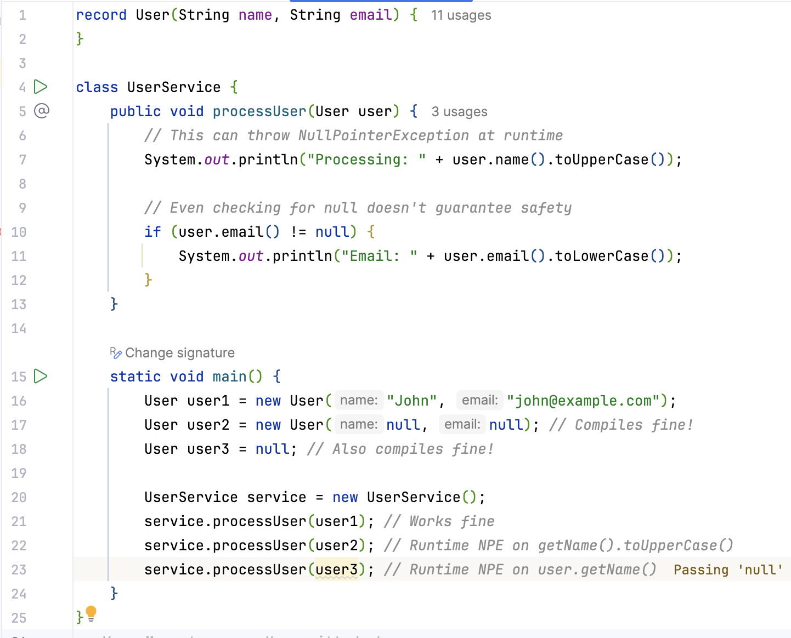
Java
Not null safe

Slide 11
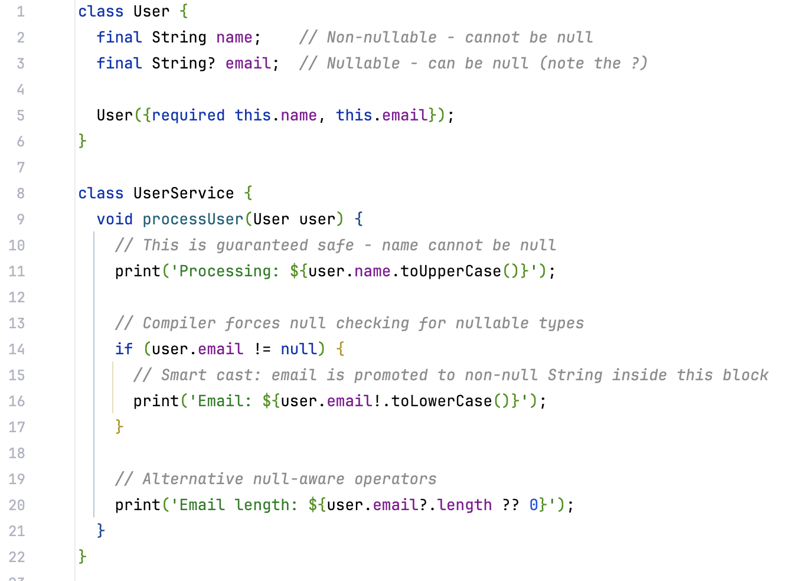
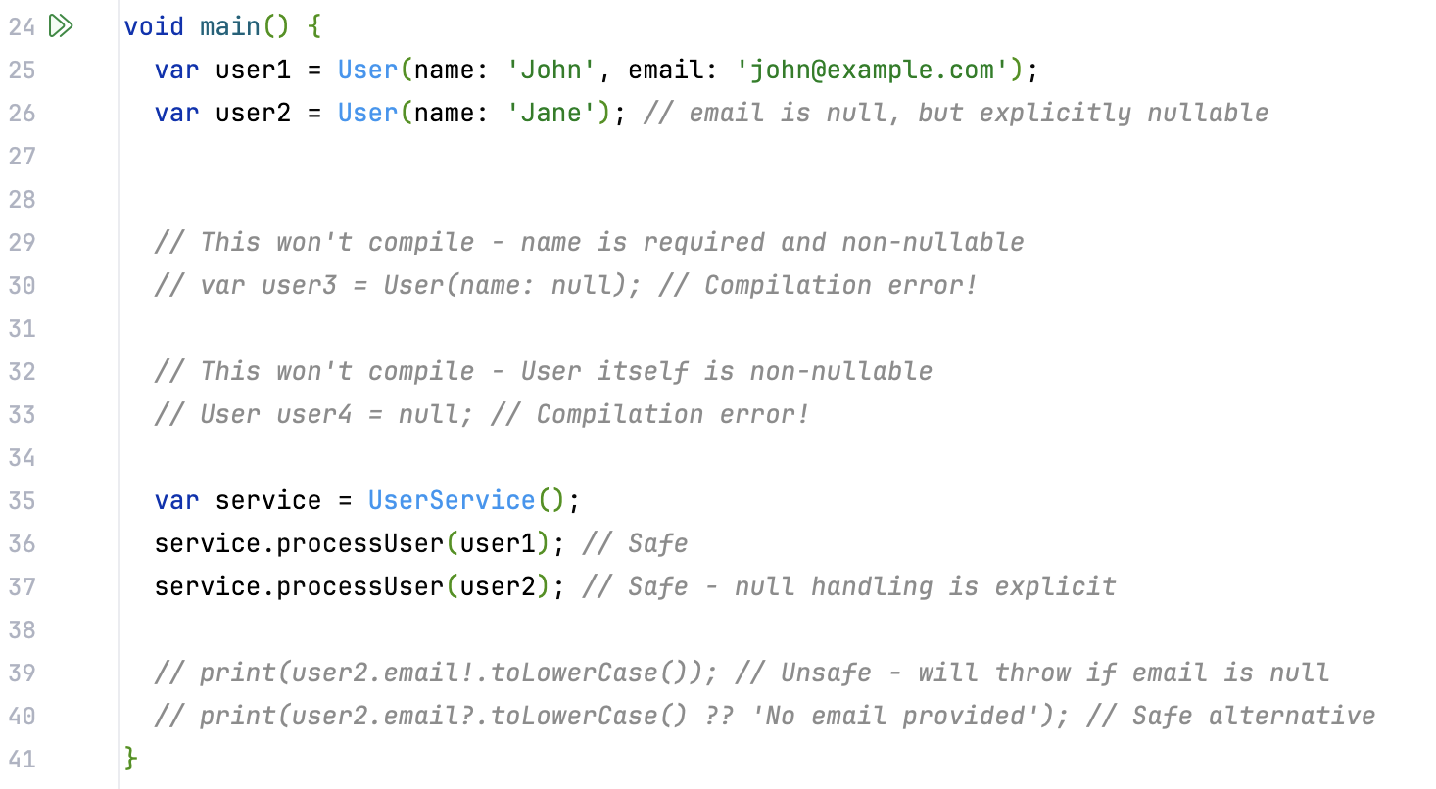
Dart – Null safe

Slide 12
Dart
client-optimized programming language developed by Google
released in 2011
Strong typed
Null safe
Object Oriented
Built in support for Async programming
Garbage collected
Can hot reload

Slide 13
Dart Garbage Collector
Two generation approach (Young generation and Old generation)
Objects that survive multiple young generation collections are promoted to the old generation.
The Dart VM implements concurrent marking for old generation collections. The marking phase runs concurrently with the application (mutator), reducing pause times. The collector uses write barriers to track modifications made by the application during concurrent marking, ensuring collection correctness.
Incremental Sweeping The sweep phase can be performed incrementally, spreading the work across multiple small time slices rather than completing it all at once. This further reduces pause times by avoiding long stop-the-world phases.

Slide 14
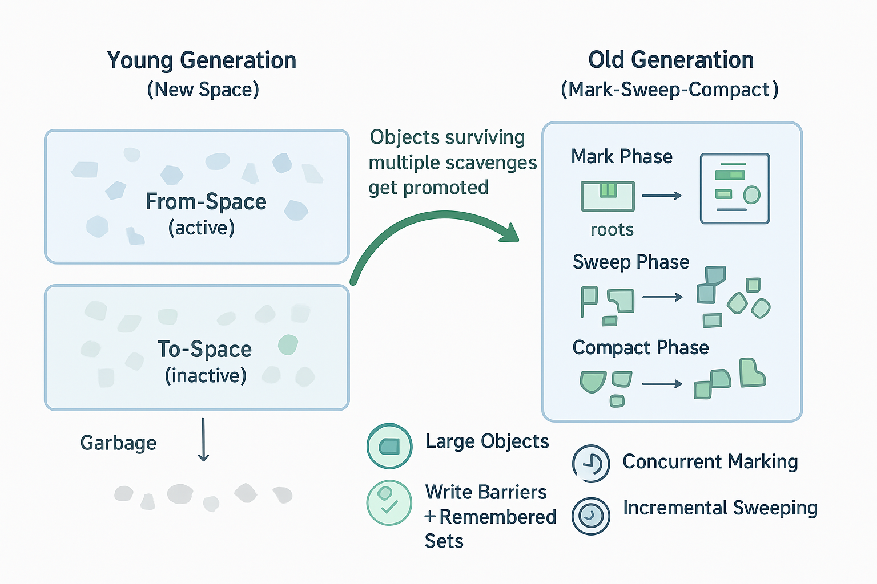

Slide 15
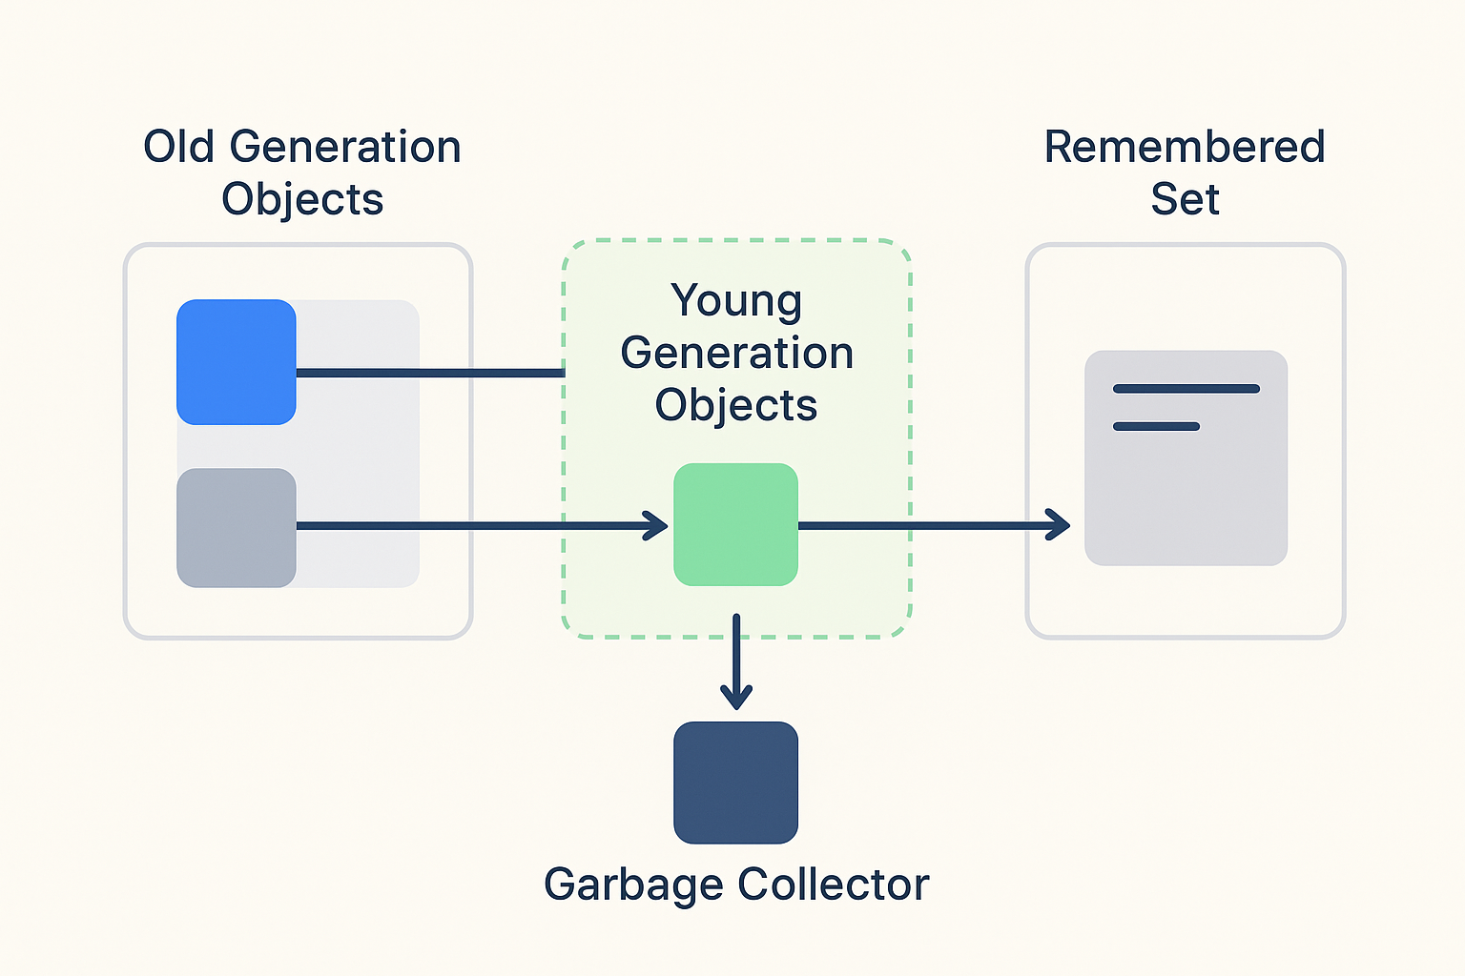
In a generational garbage collector, the young generation is collected independently and much more frequently than the old generation. However, this creates a fundamental problem: what if an old generation object holds the only reference to a young generation object?
A remembered set is a data structure that tracks references from the old generation to the young generation. Think of it as a "reminder list" that tells the young generation collector: "Don't forget to check these old objects when determining what's reachable in the young generation."

Slide 16
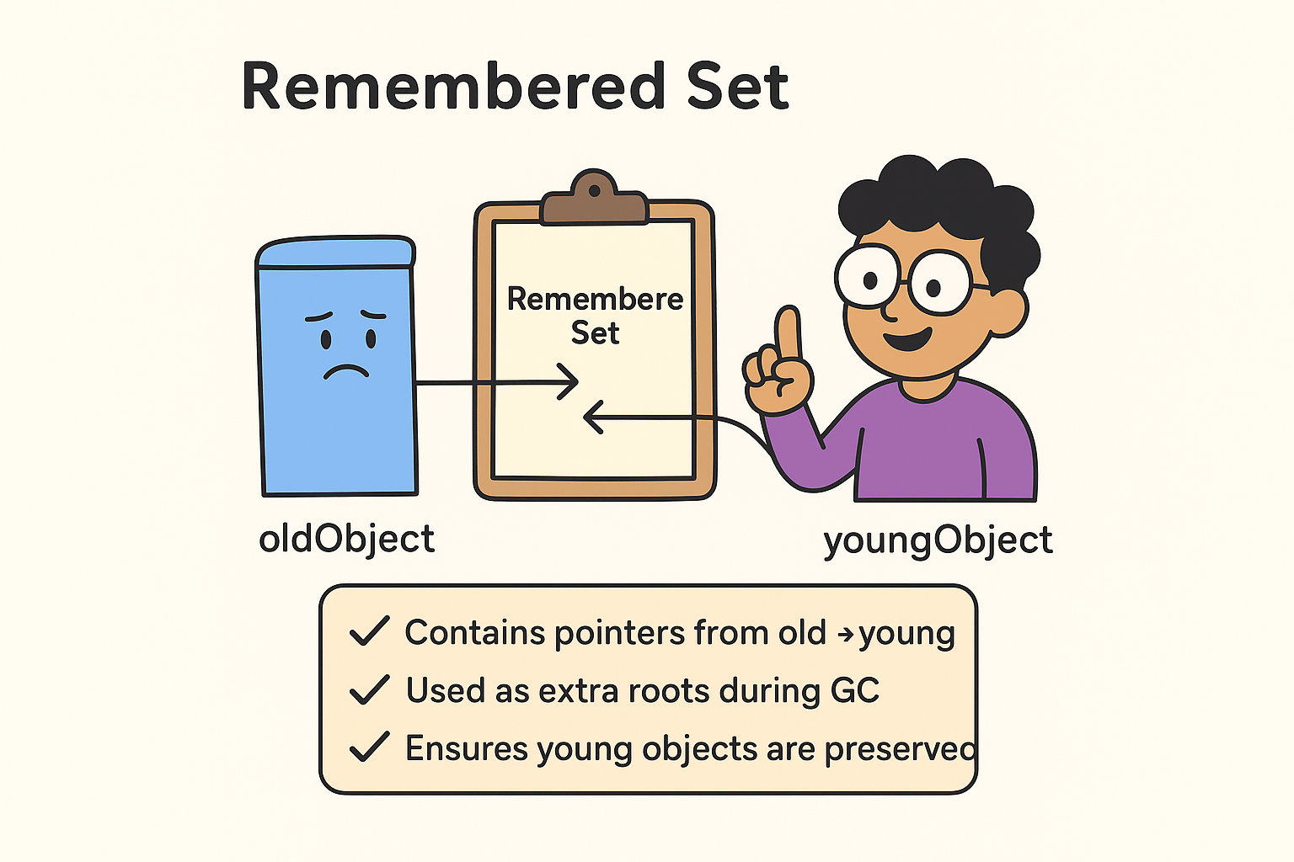
The remembered set typically contains:
Pointers to old generation objects that reference young generation objects
The specific memory locations (slots) within old objects that contain young generation references
When performing a young generation collection, the garbage collector treats the remembered set as additional "roots" for reachability analysis. It scans all objects referenced in the remembered set to find young generation objects that should be preserved.

Slide 17
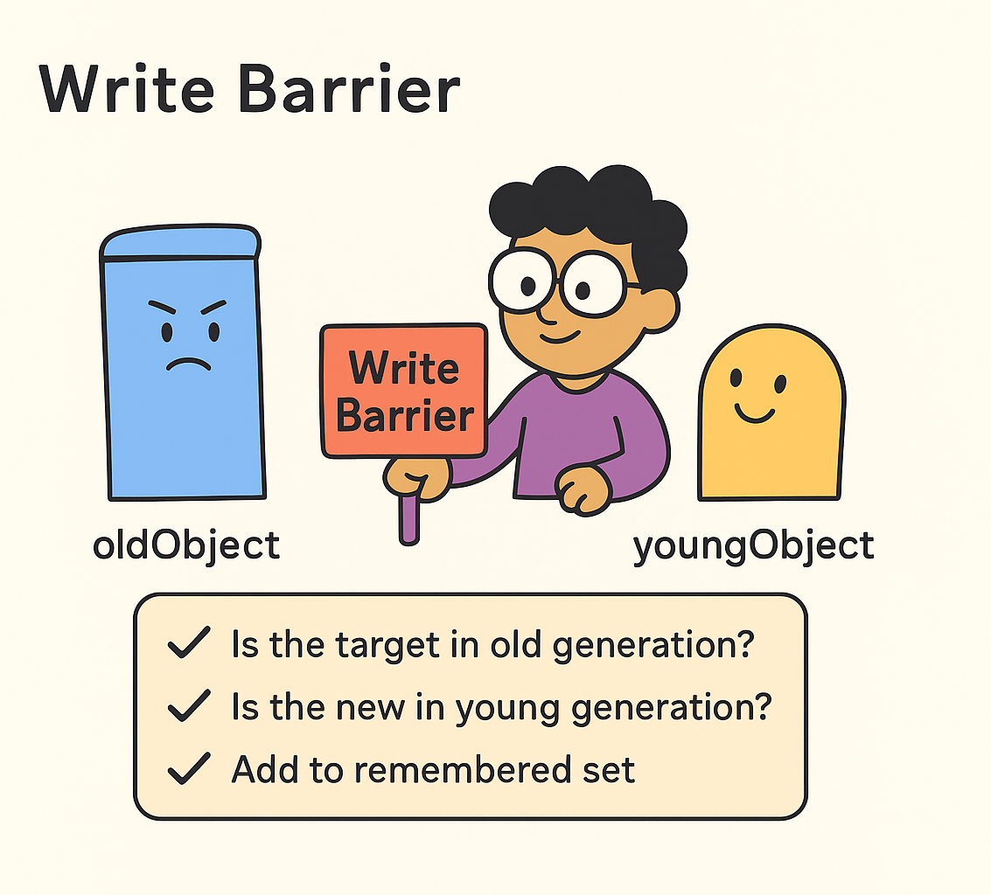
A write barrier is a small piece of code that executes whenever the application modifies an object reference. It acts as a "hook" that allows the garbage collector to monitor and respond to changes in the object graph.
When the application executes code like oldObject.field = youngObject, the write barrier triggers and performs these steps:
Is the target object (oldObject) in the old generation?
Is the new reference (youngObject) in the young generation?
=> If both conditions are true, add information about this reference to the remembered set

Slide 18
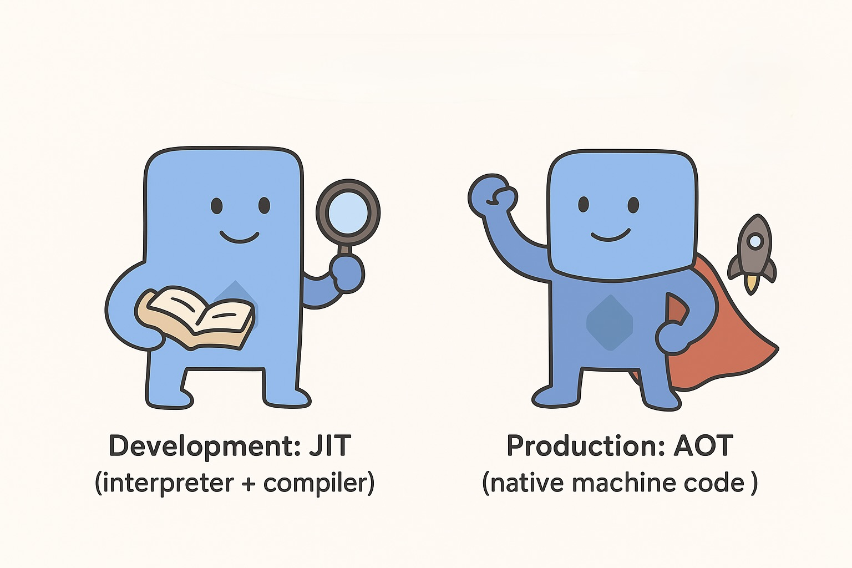
Dart VM
During development operates in JIT mode (Dart source code is initially parsed and executed through an interpreter)
In production runs in AOT mode (compiled ahead-of-time to native machine code, eliminating the VM overhead entirely. AOT compilation produces standalone executables or libraries that start faster and consume less memory than JIT-compiled applications)

Slide 19

Dart concurrency
Isolates (independent workers that communicate through message passing, each Isolate has its own memory heap and event loop)
Async

Slide 20


Flutter

Slide 21


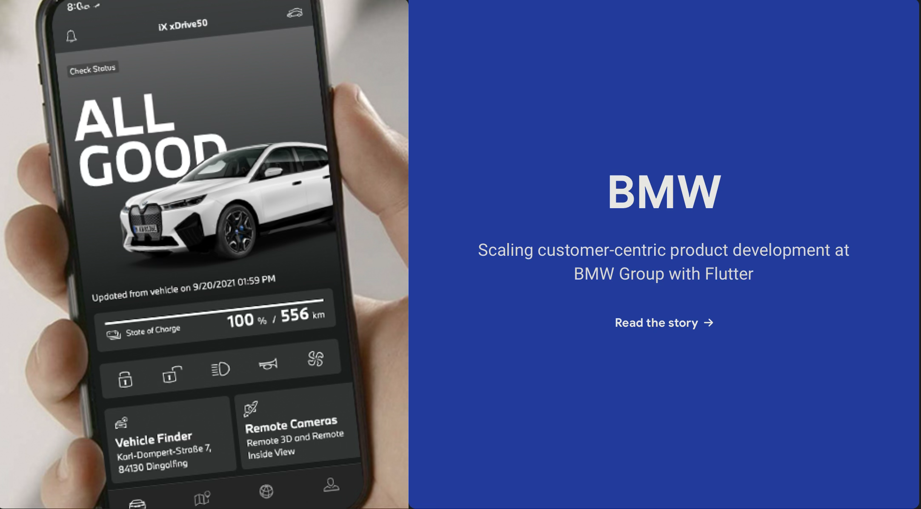
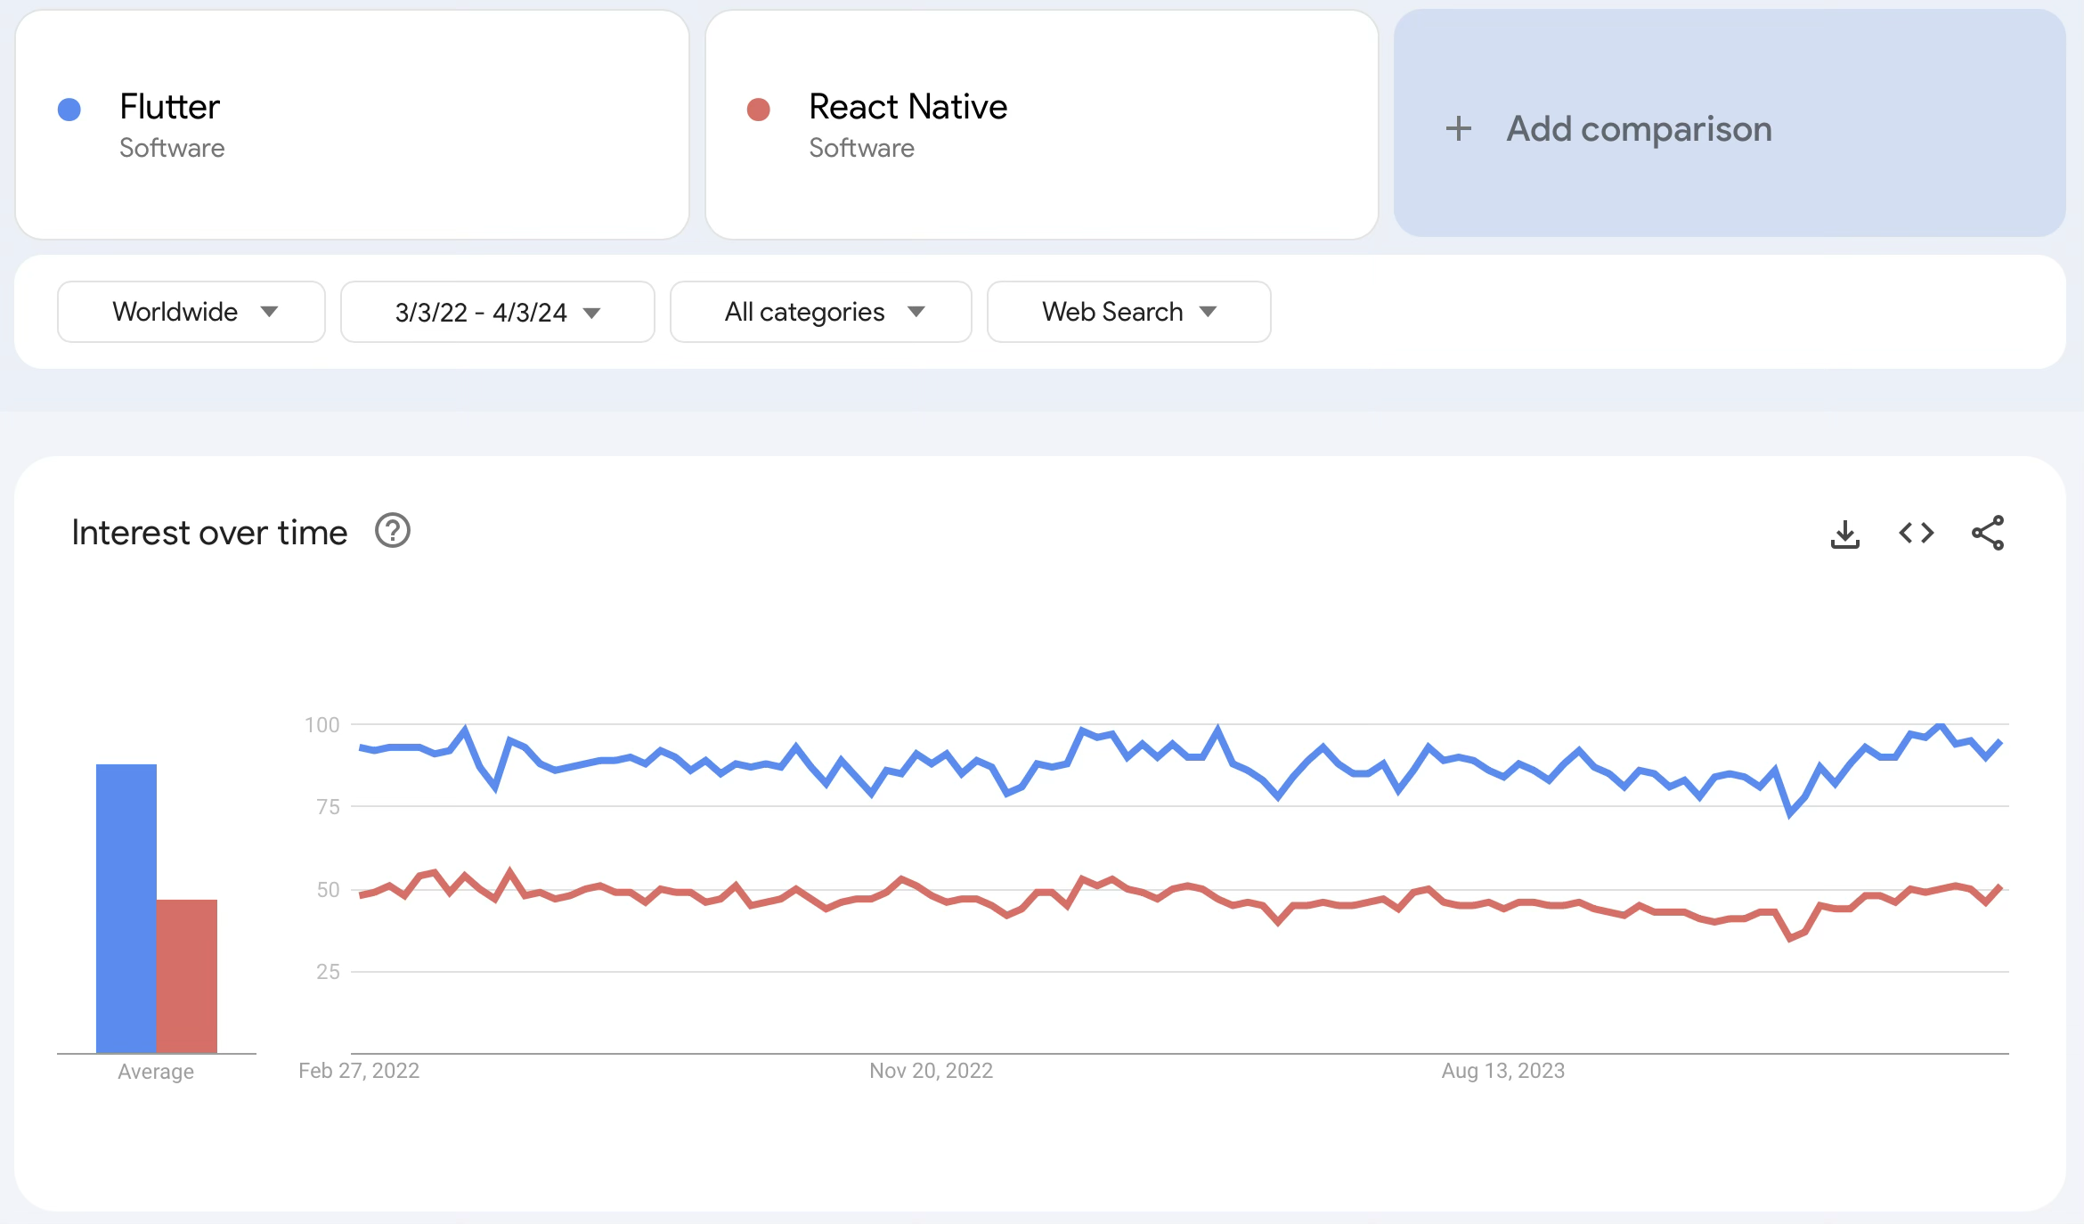

Slide 22

250k+ installs
Flutter + Spring Boot, Firebase
https://scanneralimente.ro
+45 other apps

Slide 23

Google's open-source UI toolkit for building natively compiled applications across multiple platforms from a single codebase
Uses the Dart programming language and provides a rich set of pre-designed widgets that follow platform-specific design guidelines
Excels at creating cross-platform mobile applications (iOS and Android) with almost native performance
Well-suited for apps requiring custom UI designs, complex animations, and rapid prototyping
Supports web and desktop development
Hot reload
Widget-based architecture
Not be ideal for applications requiring extensive platform-specific integrations, heavy reliance on native device APIs, or projects where app size is critical (Flutter apps tend to be larger than native equivalents).

Slide 24





Flutter and your development environment:
Flutter SDK (https://docs.flutter.dev/install) (click on Install manually)
Android Studio / Xcode
IntelliJ or VS Code to write the code (with the Flutter and Dart plugins)

Slide 25
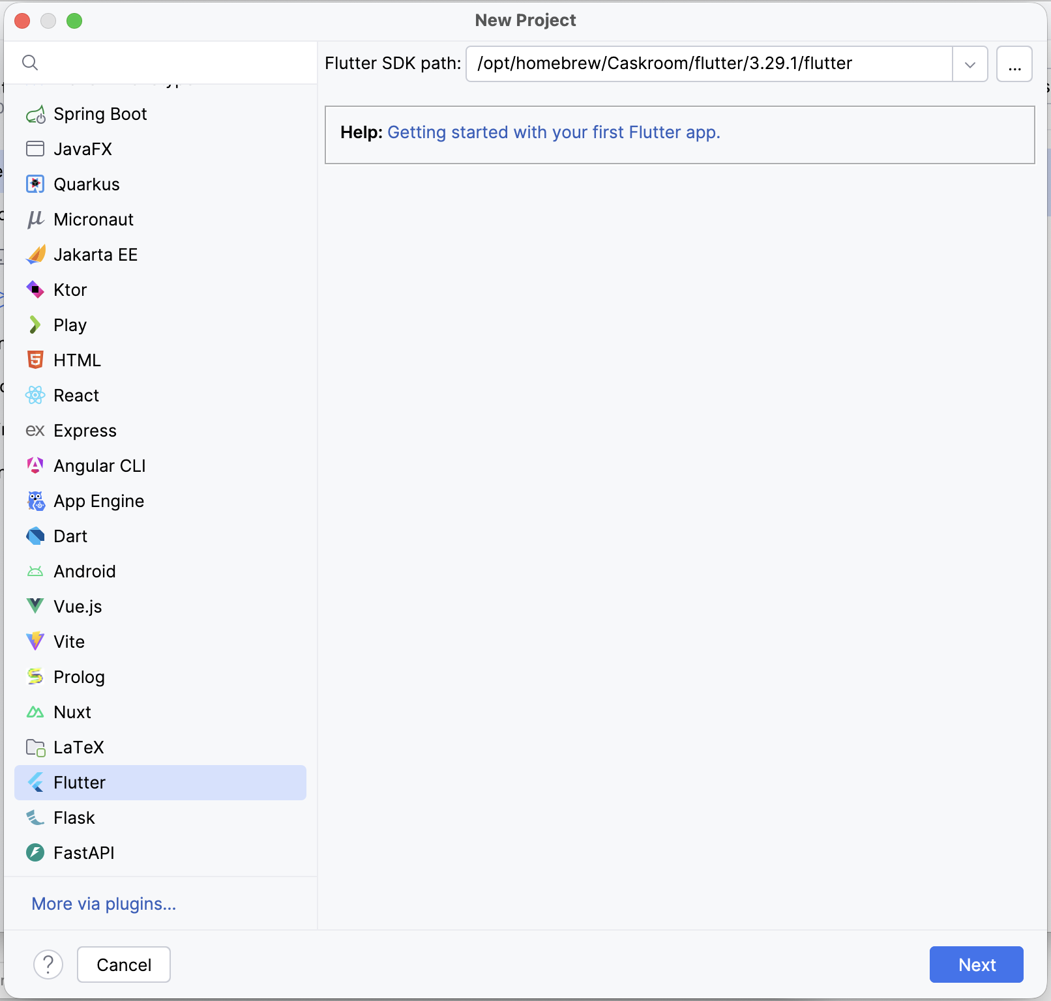
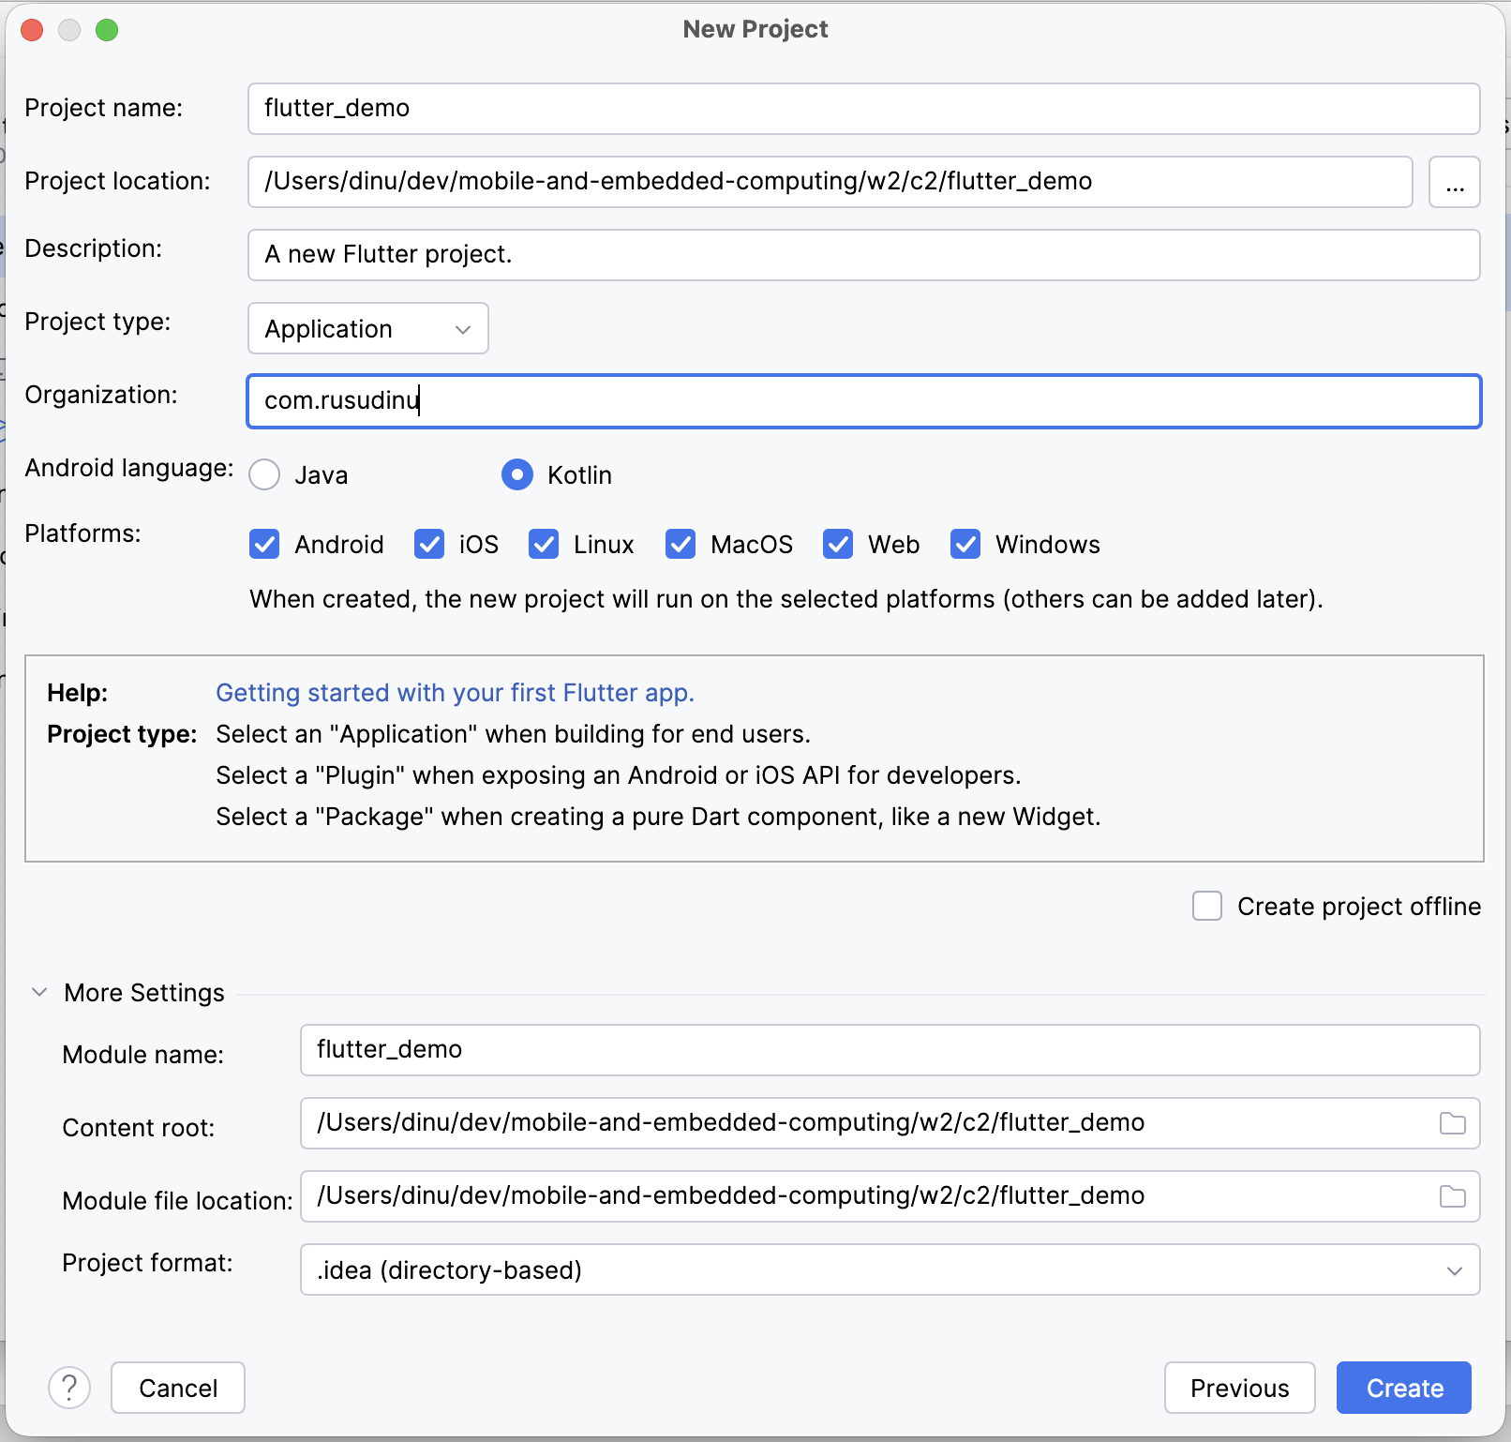

Slide 26
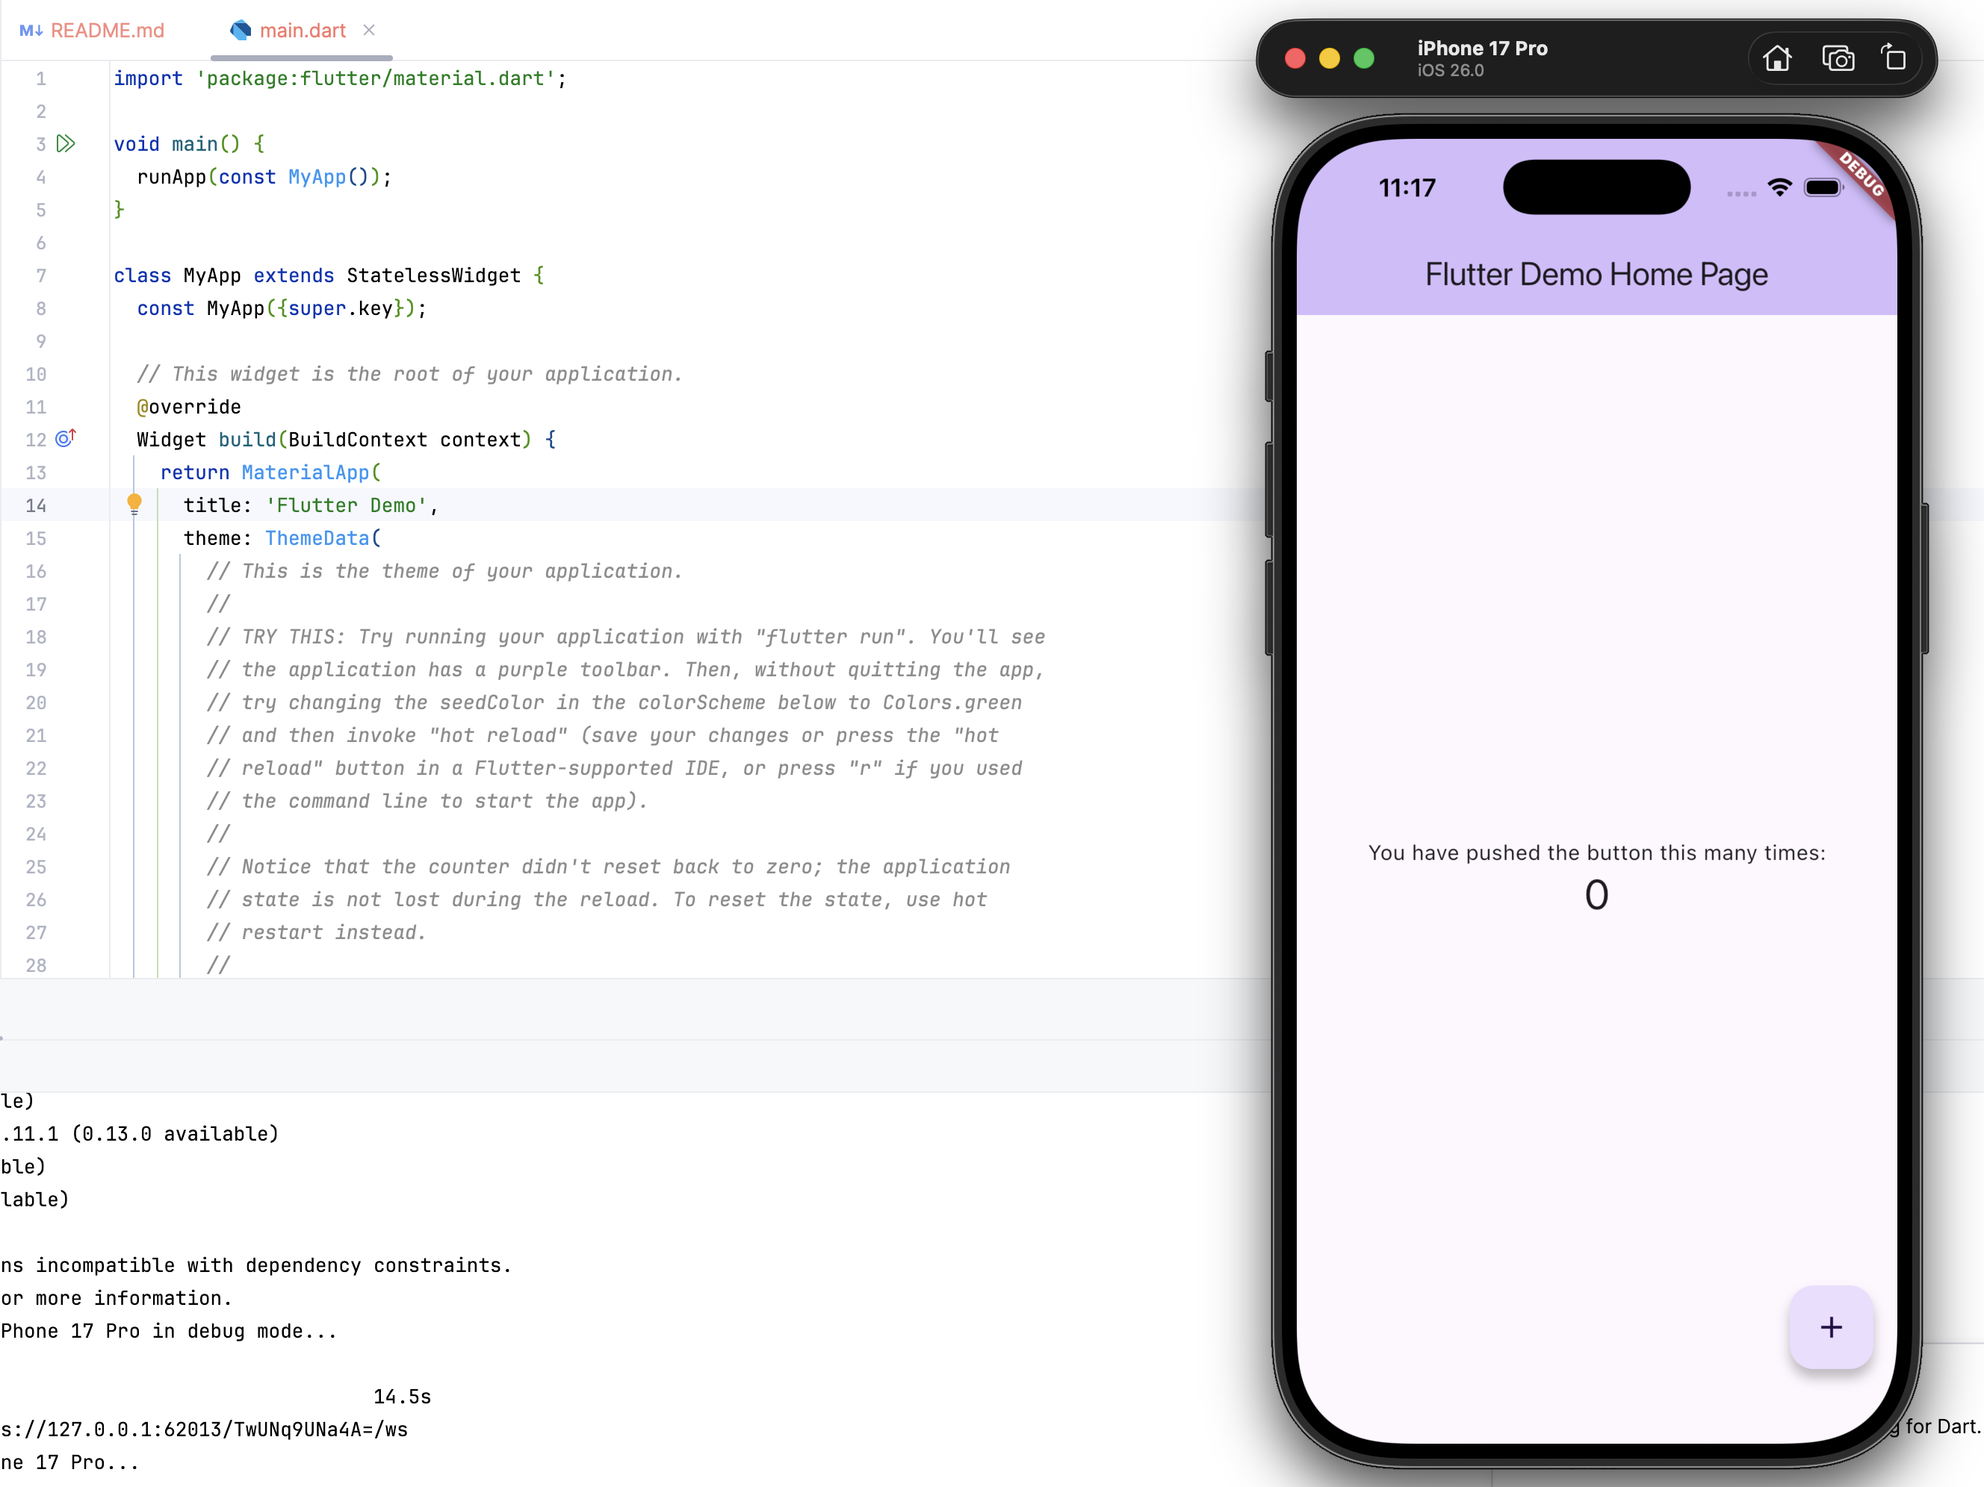
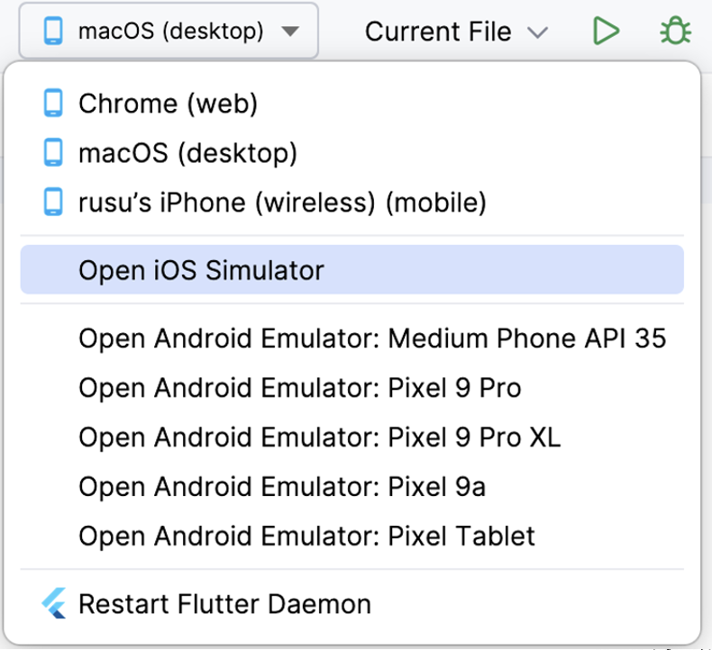

Slide 27
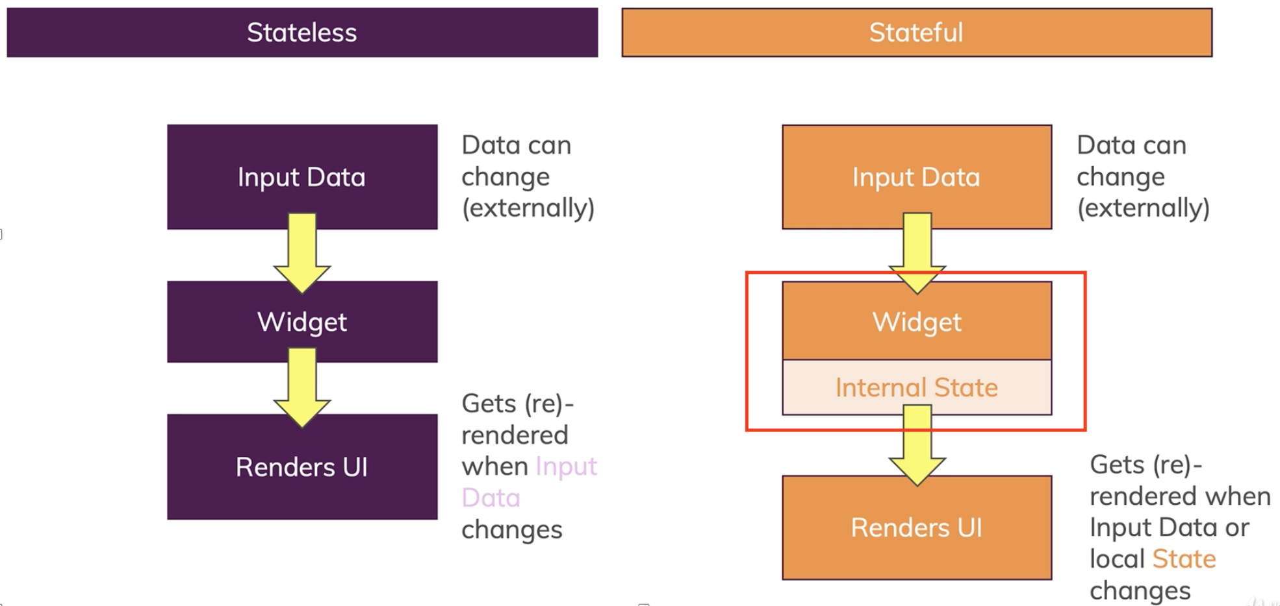
Stateless vs Stateful

Slide 28
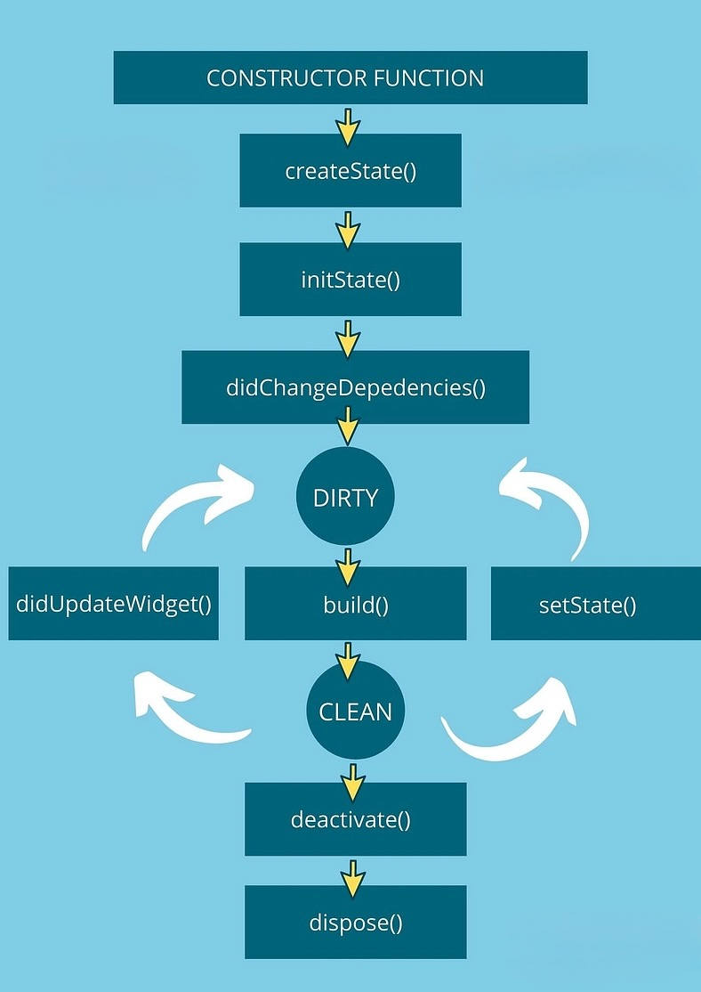
Flutter Widget Lifecycle

